Slide 1
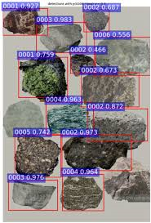
Rock Identification Using Deep Convolution Neural Network
Sana kausar khazi

Slide 2
Project Description
Building a model to classify images of rocks into their appropriate categories using the dataset. Using CNN (python 3.8 Keras and tensorflow)
TensorFlow is an open-source software library for dataflow programming across a range of tasks. It is a symbolic math library, and is also used for machine learning applications such as neural networks.
Keras is an open-source neural-network library written in Python. It is capable of running on top of TensorFlow, Microsoft Cognitive Toolkit, R, Theano, or PlaidML.Designed to enable fast experimentation with deep neural networks, it focuses on being user-friendly, modular, and extensible

Slide 3
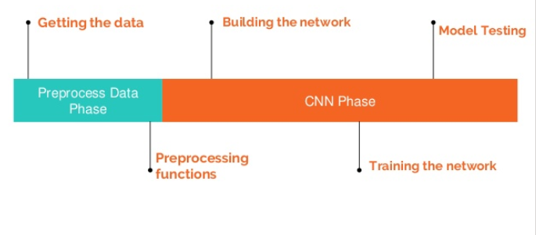
Phases

Slide 4
Preprocess functions
Normalization
Transforming image X into a NumPy array.
One Hot Encoding
Labeling the images into 0 or 1, by indexing the clases giving 1 to the class and 0 to the rest of the classes.
Randomize the data
Making sure that the data is as random as possible, to insure maximum randomization

Slide 5
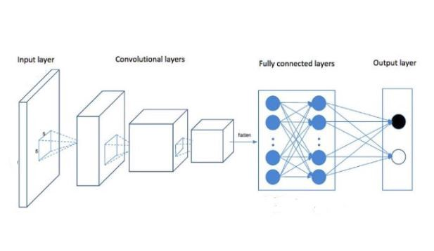
CNN
In machine learning, a convolutional neural network is a class of deep, feed-forward artificial neural networks that has successfully been applied to analyzing visual imagery. CNNs use a variation of multilayer perceptrons designed to require minimal preprocessing. They are also known as shift invariant or space invariant artificial neural networks (SIANN), based on their shared-weights architecture and translation invariance characteristics.

Slide 6
CNN Building Blocks of TEST and Train
Convolutional Layer
Pooling Layer
ReLU Layer
Fully Connected Layer
Loss Layer

Slide 7
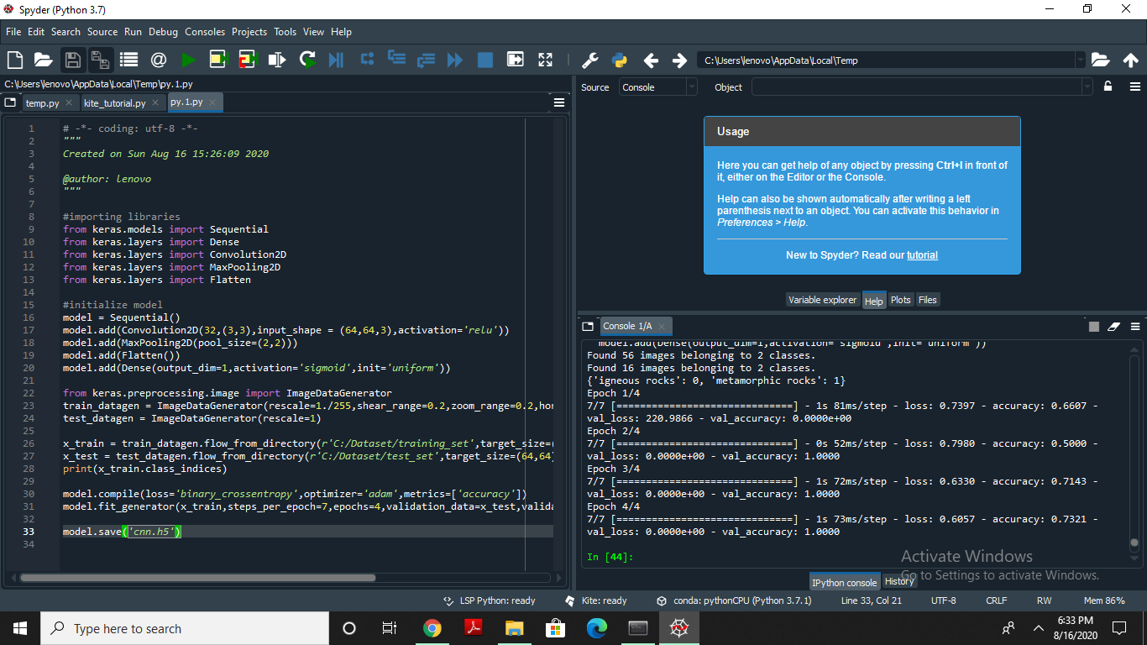

Slide 8
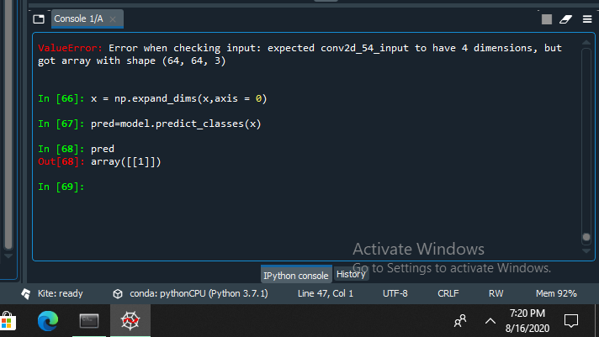
Predictions

Slide 9
Thank you.

